Slide 1


Hadoop – Auction House Statistics
By: Luis Marion

Slide 2
Background/Purpose
World of Warcraft is an MMORPG
Massive Multiplayer Online Role Playing Game
WoW contains an in game Auction House
Think Ebay for in game items using in game currency (in game or mobile app)
WoW is/was one of the most popular games of all time.
The purpose of the project is to perform some analysis of the in game economy.
Use this knowledge to become a WoW millionaire.

Slide 3



Food for thought… http://us.battle.net/wow/en/blog/12346804/world-of-warcraft-azeroth-by-the-numbers-1-28-2014

Slide 4




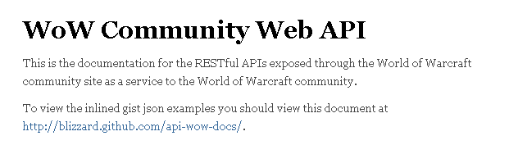

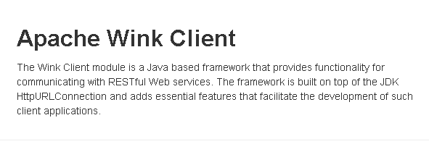

Technologies

Slide 5
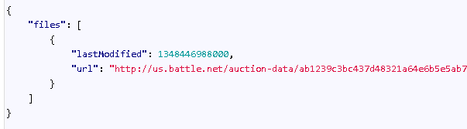
World of Warcraft API
WoW provides a Rest web-service api that exposes tons of data about the game.
http://blizzard.github.io/api-wow-docs/
This project uses Auction API exclusively
Auction API requires 2 requests
Request 1: First url contains server-name and basically returns a hyperlink to the data file and a timestamp for when the file was generated
URL = Host + "/api/wow/auction/data/" + realm
Request 2: Using url from request 1 return all of the auctions for the given server.

Slide 6
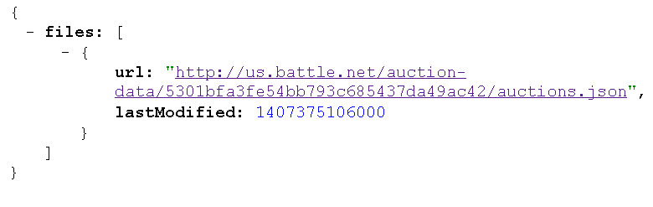
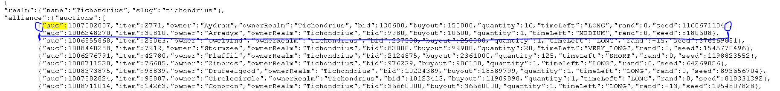
GSON – JSON library
GSON is google’s JSON library
Enables writing Java object graph to a json format (not used in project)
Enables parsing json into a Java object using reflection (used heavily)
Jackson is an alternative library – however was running into *.jar problems

Slide 7
Map/Reduce 1 – aggregate data
The first map/reduce job is strictly responsible for aggregating data.
Mapper iterates over a file containing a list of servers
Mapper will build the initial url and make the first request for the auction data-file url.
Parses the json response and builds a <server, data-file-url> (key,value pair).
Reducer makes the second request to retrieve the json file
emits the entire file as is <server, json-file-as-string> (key, value pair)
This did not need to be a map/reduce process. But…
288 servers, so 576 sequential web-service requests would be time consuming
Even pseudo-distributed this is the longest step in the MapReduce process.

Slide 8
Map/Reduce 2 – Calculate the Mean
The mapper iterates through the giant file of auctions and breaks it up into <itemid, json-auction> (key, value pairs) and sends to reducer
The json object is parsed reflectively using gson into a java object.
Reducer iterates through json auctions and calculates the average buyout price
Parse json into Java object using gson
Iterate through values and perform arithmetic operations on them
Count the total number of auctions
Keep a running sum of all the unitBuyouts (unit buyout = buyout/quantity)
Once iteration is complete, emit a special mean object.

Slide 9
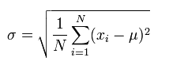
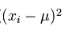
Map/Reduce 3 – Generate the report (standard deviation)
This was the hardest part by far.
Standard Deviation :
N is total number of elements in the set (i.e. the total number of auctions per item)
µ is the mean (average – calculated from step 2)
The problem: the reducer for needs to know the average before taking the partial sums
Solution was to use a hack – before third job runs copy to local, then copy back to hdfs.
Correct way would have been to use MultipleOutputs or MultipleInputs neither of which work with in Hadoop 0.20.2

Slide 10
Results
288 servers are split by 2 factions and 3 auction houses (horde, alliance, neutral)
application does not distinguish by faction
Aggregated auction file is 1.8 GB in size.
Running against all 288 servers took roughly 1.5 hours using Eclipse (most of the time was spent in REST calls)
Live Demo…

Slide 11


What’s Next?
Upgrade hadoop version and fix the report job hack.
Better error handling – web-service failure kills job as opposed to skipping server
Extend application to look at data trends over time.
API does not store historical data however if I could pull data on a set interval and store it
MapReduce job requires minimal changes as the AuctionStatsMapper/Reducer can read all files from a directory (so just put all historical files from same server in same directory)
Extend the application to work with other similar games.
Use item ids to retrieve actual item names (id’s are meaningless to people for human readable)
Problem here is there is a cap on number of requests per day from a given IP (3000 – which would easily be exceeded with just1 servers auctions)
So data would have to be collected and stored locally.

Slide 12

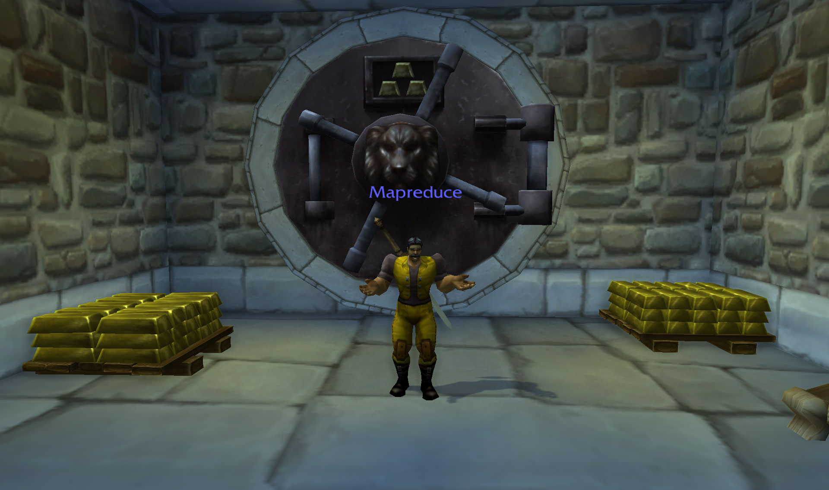
Questions

